Slide 1
AIGS1006 Deep Learning Group Project
Group 3 :
Yukti
Sudhan
Nonso
Altamash

Slide 2
Convolutional Neural Network – Model Summary
Implementation 1
2 CNN
3 hidden layers
No Dropout
Softmax activation function
Sparse Categorical Cross Entropy
Common Features
Optimizer – Adam
Activation Function – Softmax, Relu
Loss Function = Categorical Cross-Entropy loss
Implementation 2
3 CNN
4 hidden layers
No Dropout
Relu activation function
Sparse Categorical Cross Entropy
Implementation 3
3 CNN
5 hidden layers
Dropout (30% / 50%)
Softmax activation function
Sparse Categorical Cross Entropy
Implementation 4
4 CNN
6 hidden layers
Dropout (25%)
Softmax activation function
Sparse Categorical Cross Entropy
Implementation 5
4 CNN
6 hidden layers
Dropout (20%)
Softmax activation function
Sparse Categorical Cross Entropy

Slide 3
Model Architecture Summary – Cont’d
Model Architecture | Implementation 1 | Implementation 2 | Implementation 3 | Implementation 4 | Implementation 5
Optimizer | Adam | Adam | Adam | Adam | Adam
Loss Function | Sparse Categorical Cross Entropy | Sparse Categorical Cross Entropy | Sparse Categorical Cross Entropy | Sparse Categorical Cross Entropy | Sparse Categorical Cross Entropy
No. of Epochs | 15 | 10 | 10 | 30 | 50
Validation Split | 20% | 30% | 30% | 30% | 30%
Learning Rate | NA | NA | 0.001 | NA | NA

Slide 4
Accuracy and Loss Function Analysis
Accuracy | Implementation 1 | Implementation 2 | Implementation 3 | Implementation 4 | Implementation 5
Training Data | 77.83% | 76.44% | 81.91% | 85.58% | 91.44%
Test Data | 67.24% | 68.73% | 73.62% | 77.93% | 78.78%
Loss
Training Data | 0.65 | 0.68 | 0.54 | 0.44 | 0.29
Test Data | 1.0 | 0.92 | 0.77 | 0.66 | 0.70

Slide 5
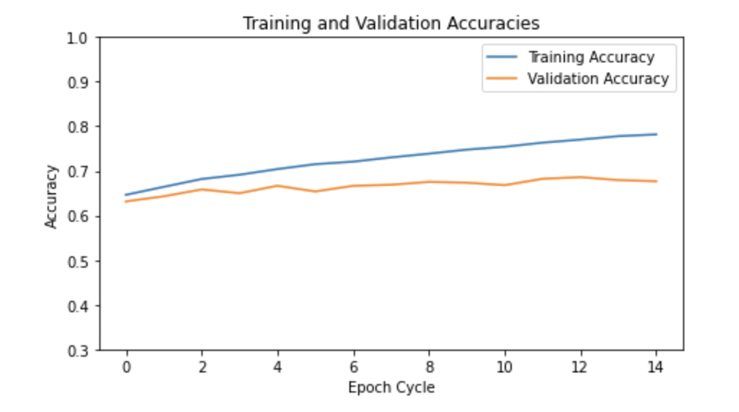
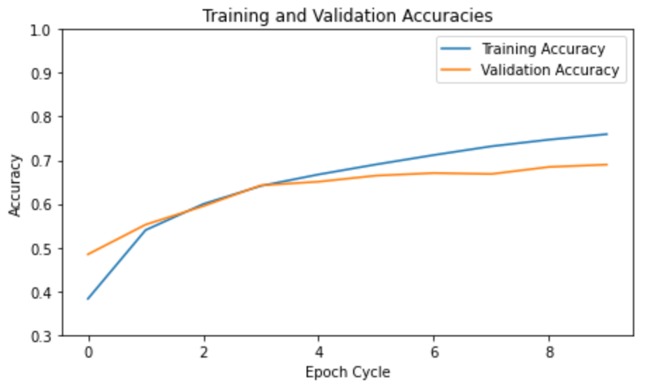
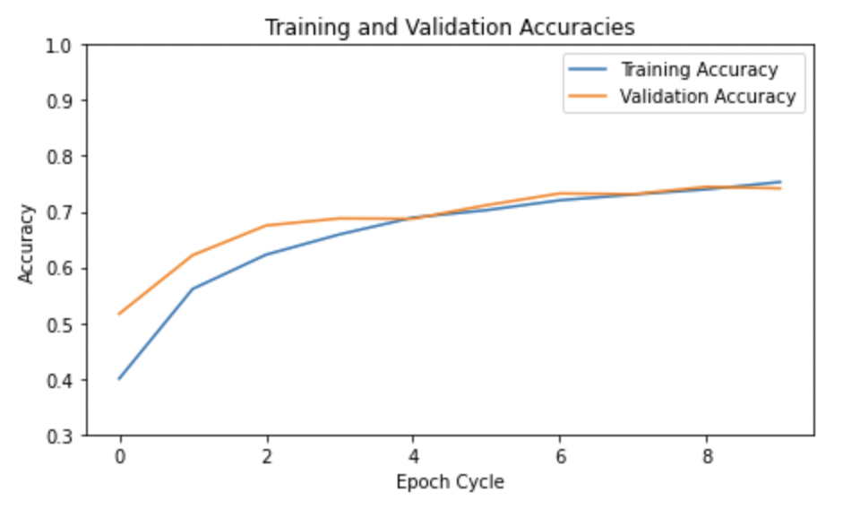
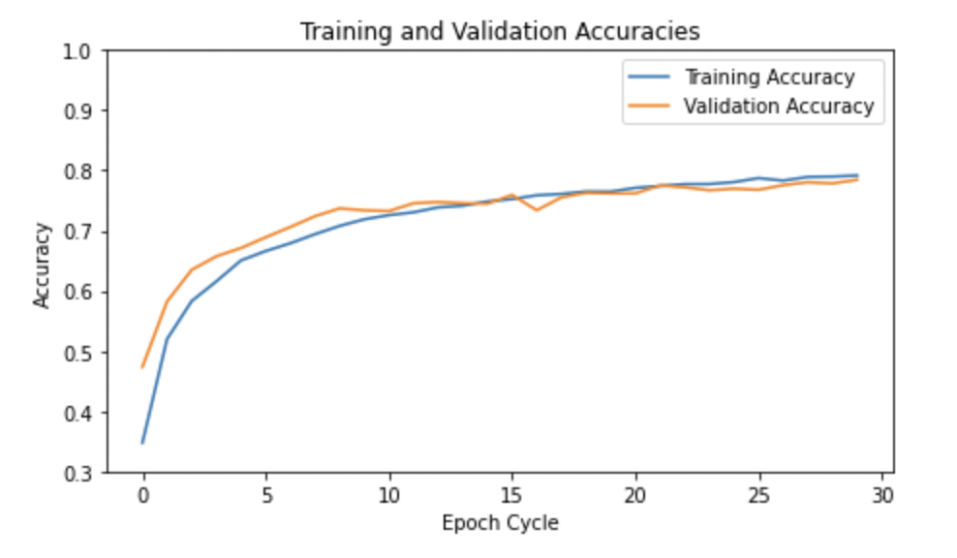
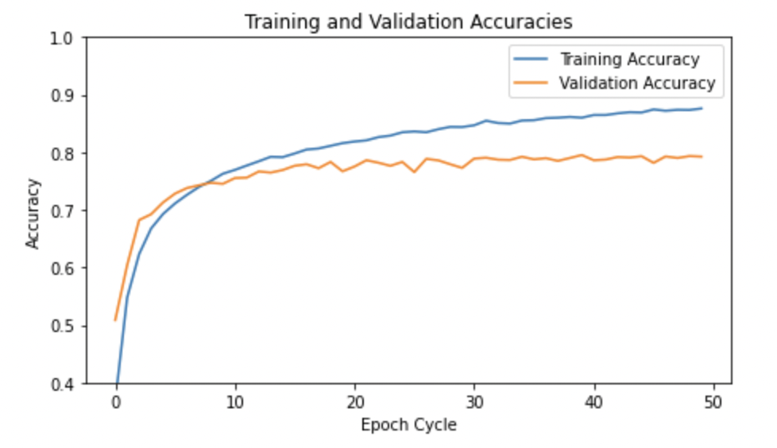
Training and Validation Accuracies Graph
Implementation 1
Implementation 2
Implementation 3
Implementation 4
Implementation 5

Slide 6
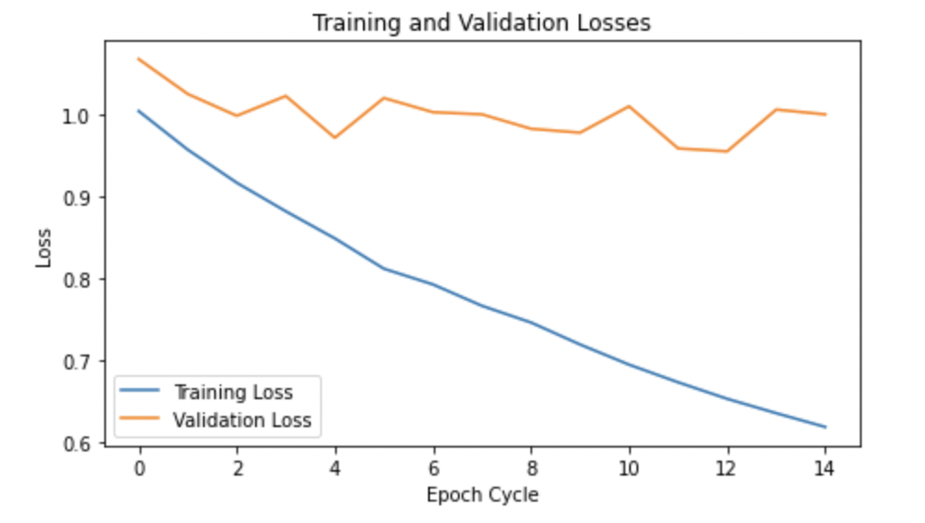
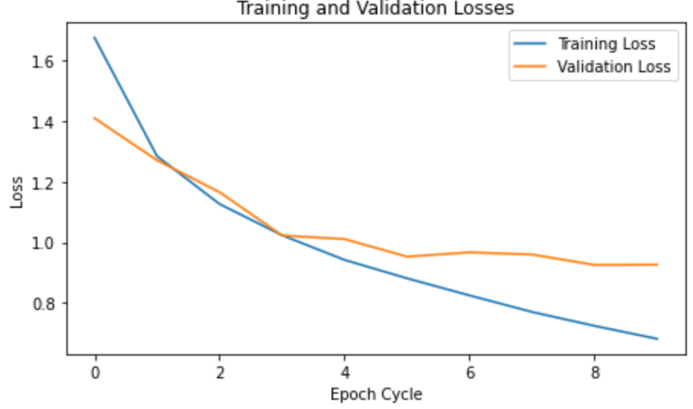
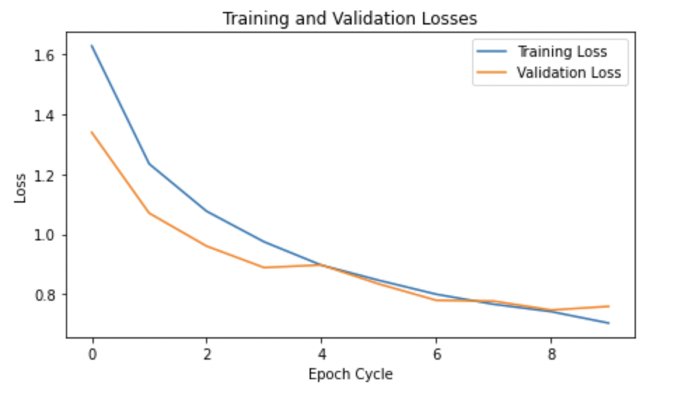
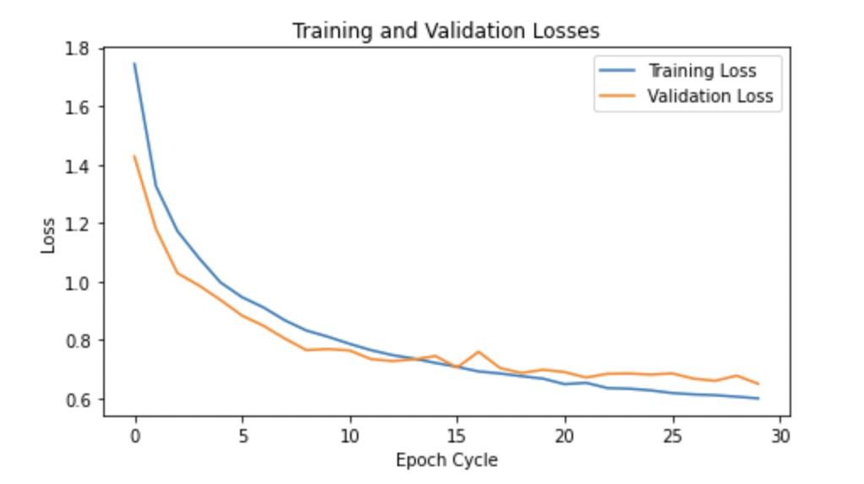
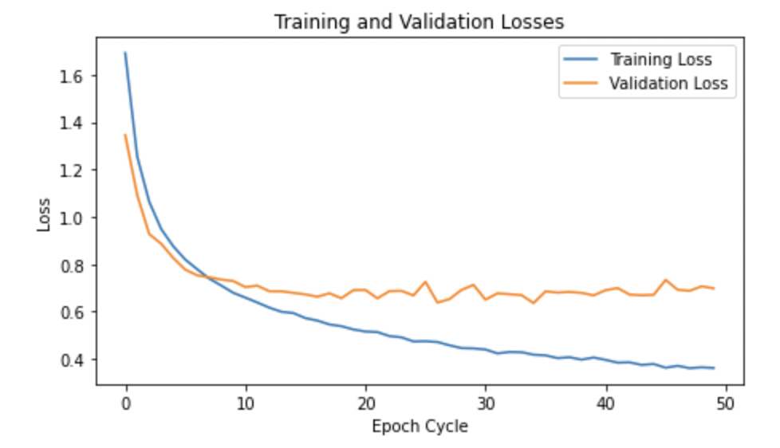
Training and Validation Losses Graph
Implementation 1
Implementation 2
Implementation 3
Implementation 4
Implementation 5

Slide 7
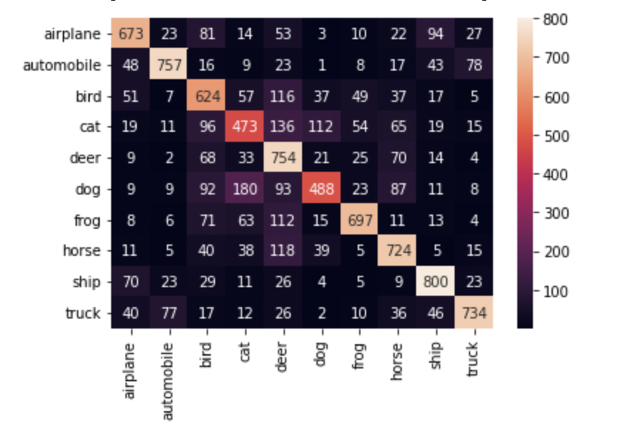
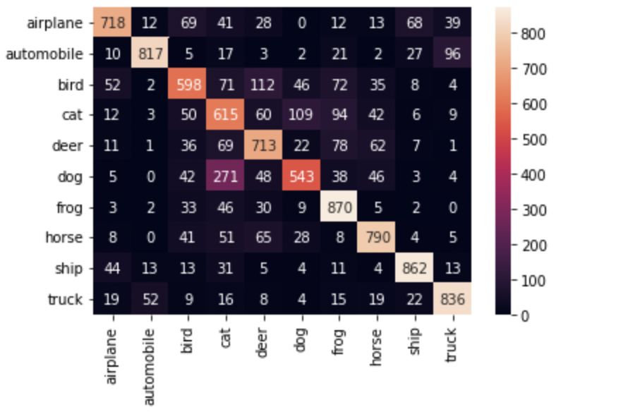
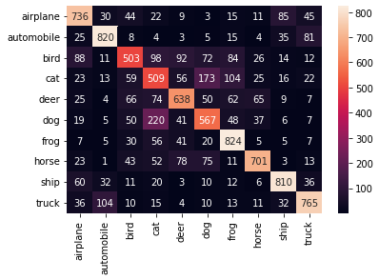
Confusion Matrix - Heat Map
Implementation 2
Implementation 1
Implementation 3

Slide 8
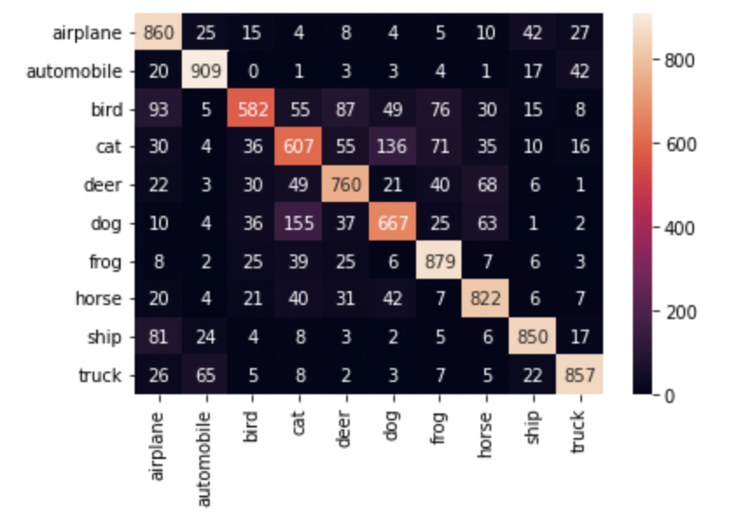
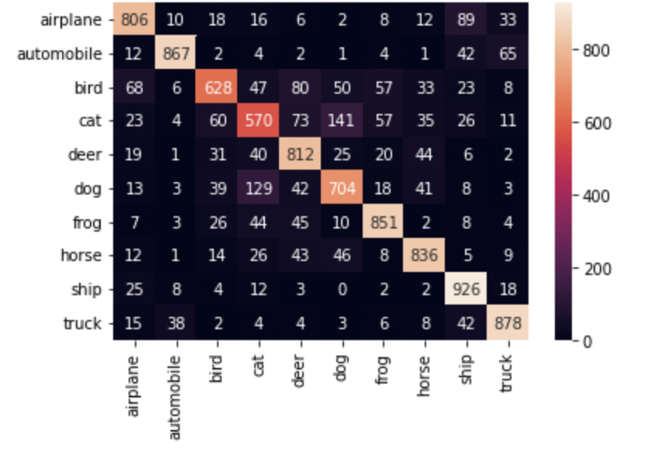
Confusion Matrix - Heat Map
Implementation 4
Implementation 5

Slide 9
Summary Findings
01 | Our model performed better with the introduction of dropout
02 | Softmax is a better activation function for classification when compared to Relu
03 | A validation split of 70 / 30 produced better training and validation accuracies as well as lower losses.
04 | The model converged better with more iterations which shows that the model has to learn sufficiently to achieve better results
05 | The quality of the images and similarities between the image classes could also have affected the model’s accuracies as the classes (Ship and Automibile) which seemed to have more distinct images had the highest prediction accuracies across all implementations while the similar classes such as cat, dog and deer had the most wrong predictions.

Slide 10
Conclusion
01
02
The classification of the images clearly shows that our model classified most of the images correctly with just 4 wrong predictions out of 25 samples in the last and most accurate implementation.
The use of dropout has made our model achieve more accuracy.

Slide 11
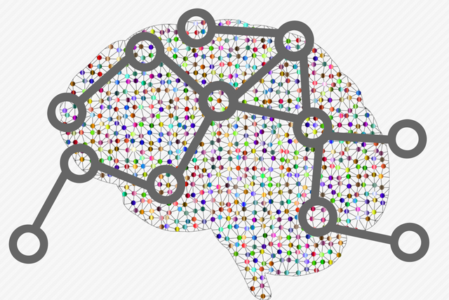

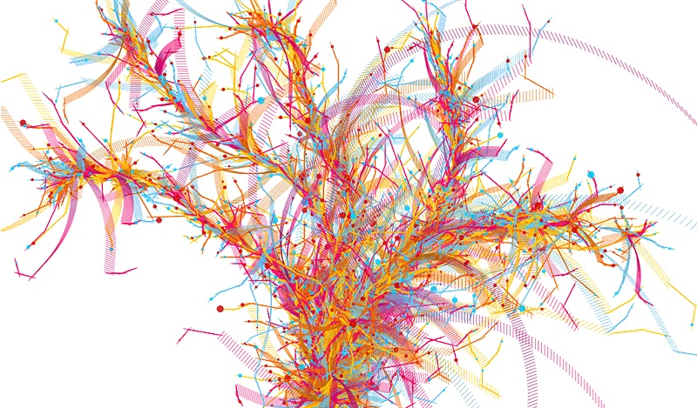
Bonus
The dataset contains 1240 folders, each folder has 1000 jpg files, and each jpg file contains 64 , 32*32 Images stacked on each other from various untrained classes.
Developed a script to extract & reshape the images according to our trained model

Slide 12

We picked SparseCategoricalCrossentropy with reduction to accept and reject predictions based on score.
We have set the threshold to 1 , while testing other class and in class images from test set.
While running 10240 images from other classes from the 80 million our model achieved a rejection rate of 79%
While running 10000 images of in class test set, we achieved an erroneous rejection rate of 94%.,
Finally ,we have presented 64 images from img_0.jpg of image_0 folder
from which the threshold must be lowered to balance out the erroneous rejection of in class images.

